Slide 1
DEEP LEARNING
The Reg challenge
Jose Antonio Ruiz Heredia
Hector Carlos Flores Reynoso
Alvaro Honrubia

Slide 2
THE PROBLEM
Problem
Scope
Observations
Given a set of images (224px, 224px) create a classifier that is able to detect the vehicle type.
Refine the Forward-Feed Neural Network and optimize its parameters using regularization techniques
Models are compared using metrics such a mean accuracy, recall and precision.

Slide 3
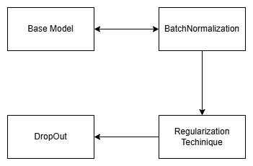
THE PROCESS
00
01
02
03
Different Epochs (60-100)
Batch Normalization
Before
After
Regularization
Lasso (L1)
Ridge (L2)
Dropout Range
0.1 - 0.6
Base Model

Slide 4
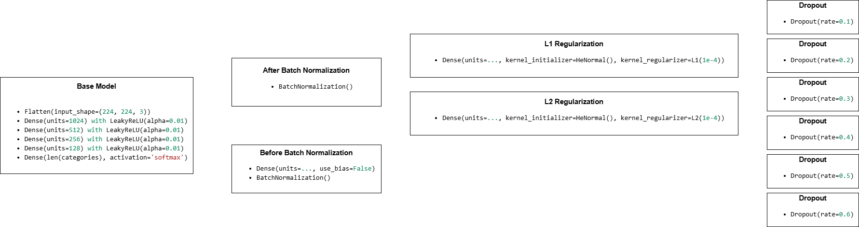
Model Architectures
Batch normalization was tested both before and after the activation function, with better results achieved when applied before activation.
L1 and L2 regularization were tested with and without bias_regularizer and activity_regularizer. The default configuration obtained the best performance.
Dropout is applied across different layers, with the optimal variation found to be a gradual decrease of 0.4, 0.3, 0.2 and 0.1

Slide 5
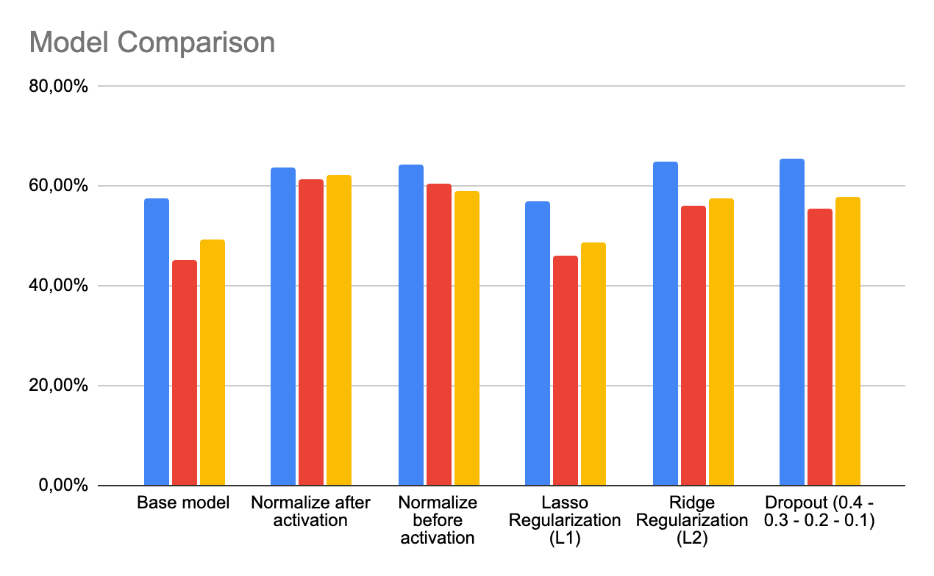
MODEL METRICS
BEST MODEL
Normalize before activation
Ridge (L2) Regularization
Dropout (0.4 - 0.3 - 0.2 - 0.1)
Accuracy
Recall
Precision

Slide 6
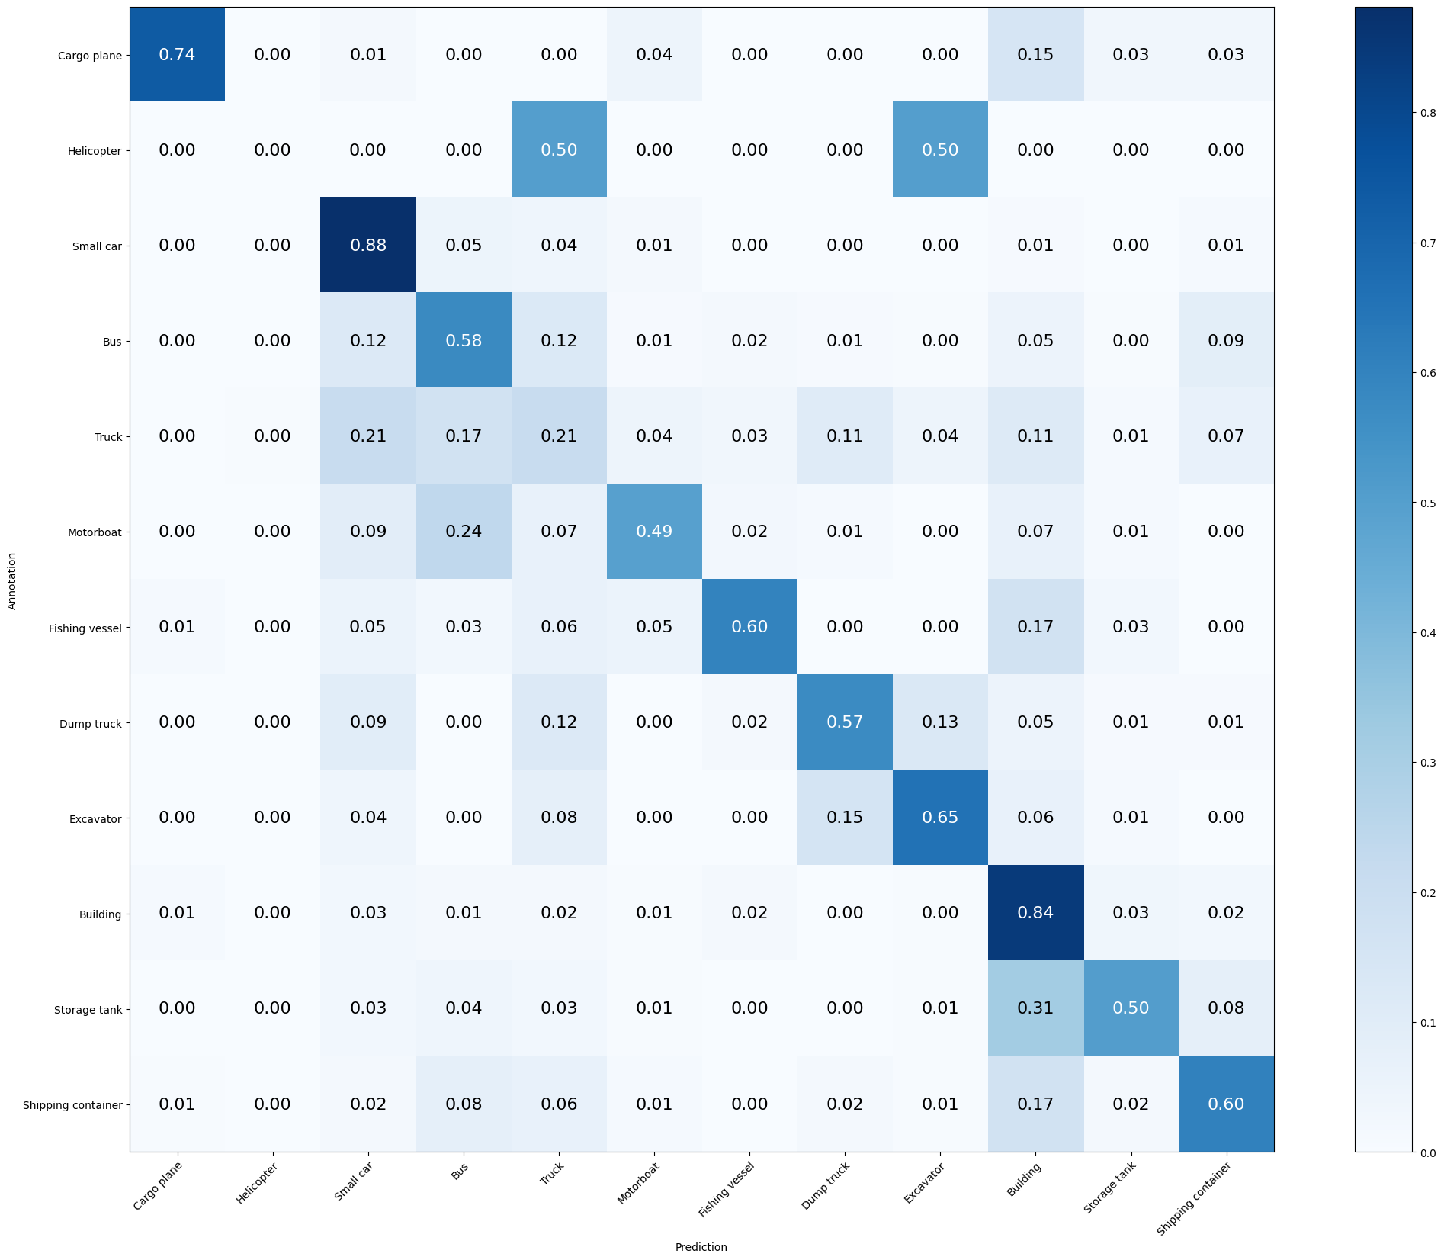
BEST MODEL
Mean Accuracy: 65.388%
Mean Recall: 55.578%
Mean Precision: 57.930%
Cargo plane: Recall: 73.529% Precision: 86.207% Specificity: 99.614% Dice: 79.365%
Helicopter: Recall: 0.000% Precision: 0.000% Specificity: 99.953% Dice: 0.000%
Small car: Recall: 88.095% Precision: 74.148% Specificity: 92.491% Dice: 80.522%
Bus: Recall: 57.534% Precision: 53.165% Specificity: 94.216% Dice: 55.263%
Truck: Recall: 20.755% Precision: 35.948% Specificity: 94.768% Dice: 26.316%
Motorboat: Recall: 49.438% Precision: 57.895% Specificity: 98.438% Dice: 53.333%
Fishing vessel: Recall: 59.740% Precision: 65.714% Specificity: 98.836% Dice: 62.585%
Dump truck: Recall: 57.265% Precision: 58.772% Specificity: 97.674% Dice: 58.009%
Excavator: Recall: 65.385% Precision: 61.446% Specificity: 98.447% Dice: 63.354%
Building: Recall: 84.476% Precision: 72.491% Specificity: 90.317% Dice: 78.026%
Storage tank: Recall: 50.327% Precision: 71.963% Specificity: 98.489% Dice: 59.231%
Shipping container: Recall: 60.390% Precision: 57.407% Specificity: 96.522% Dice: 58.861%

Slide 7
CONCLUSIONS
Epochs iteration
Decremental over incremental changes
Testing incremental changes
When trying different regularization techniques is better to have a high number of epochs and do early stops
Steady layers always are outperformed by decrease hyperparameters in layers
Testing isolated features is better than randomizing the approach of different configurations

